Slide 1
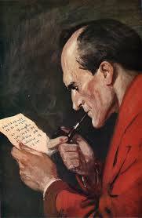
Verb Detective
Verb Conjugation Correcter
Simon Dahlberg

Slide 2
Idea: Create a program that can correct a verb that has been wrongly conjugated and/or misspelled.
Input: A string (a verb)
Output: A string (the corrected form of the input verb) If the input string was a correctly conjugated verb, it should output the same string
Two examples: Input “gådde” -> ouput “gick” Input “gick” -> ouput “gick”
Basically, the program solves a morphological problem related to incorrect language use. It is different from spell checkers in the sense that it doesn’t simply check for similarities to other words, having the ability to do a relatively complex morphological analysis.

Slide 3
Modules:
- Ord Class Four attributes: two for classifing the word’s tense and the complexity of its correction, and the other two for saving the input string in one place and the string used for manipulation (to accomplish correction) in another. Only two methods; define if passive and to define tense - VerbDetektiv Class (VD) Two attributes: one verblist and one big dictionary, both from text files. The verblist is used for checking if the verb exists in its current manipulated form. The dictionary is used for a last check-up when the correction has not given any result. Many methods, one for checking the word in the dictionary and the rest for manipulating the string. VD operates on an Ord object, most of its methods requires an Ord object as a parameter. VD changes attributes of the Ord object, whereas the VD is not touched by anyone else.
- Provvokaler List A list of vowels (one character strings), used within a method for the vowel mistake check. The list is changed according to the vowel that comes with the input, in order not to do unnecessary checks

Slide 4
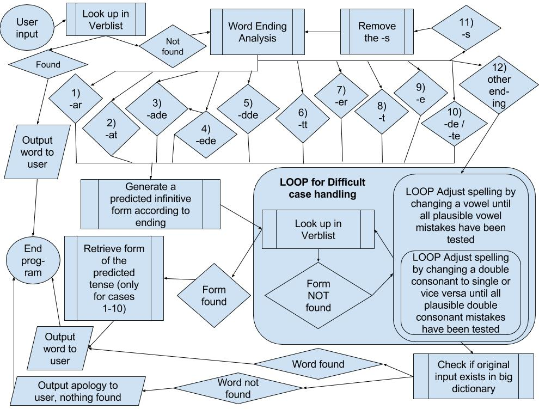
Algorithm

Slide 5
Strengths:
Understanding of the Swedish verb morphology
Ability to handle words that have both spelling and conjugation mistakes
Weaknesses:
Weak ability to handle conjugation that have “unexpected” mistakes
No ability to handle verbs that ressemble the corresponding word in English or any other foreign language
Vowel and double consonant mistake handling might result in false positives

Slide 6
Corpus:
6 files with texts written by SFI students (en_asu1 to en_asu6), provided by tutor
Other resources:
Lists of Swedish irregular verbs found on the internet: http://blog.lardigsvenska.com/2010/10/oregelbundna-verb.html
Big list of all Swedish words (Swe.dict.txt), also provided by tutor
Python webpage

